Slide 1


Minor Project
TradeHelp: A helping hand for the stock market
Presented by:
R2142210244- Charu Gupta
R2142210448- Lakshay Agarwal
Mentored By-
Dr. Niharika Singh

Slide 2
Content
Introduction
Literature Review
Objectives
Methodology
References

Slide 3
Introduction
Technical background of project
Technical Concepts (Algorithms) used
Regression model
Motivation
TradeHelp project is inspired by the growing need for reliable stock market predictions and well-informed decision-making, which aims to have important consequences for monetary gain and risk management. In this project we will combine technical expertise with a strong interest in finance, and offer helpful instructional resources for anyone looking to grasp data analysis and machine learning in a real-world setting.
Problem Statement
Developing an accurate stock market prediction system is essential due to the volatility and unpredictability of financial markets. Current methods often fall short, creating risks and missed opportunities for investors. This project aims to create a reliable predictive model to improve decision-making, managing risks, and gaining a competitive edge in the financial industry, while considering ethical and regulatory implications.
Area of application
Stock Market
Dataset and input format
Datasets
Formats: .txt and .csv

Slide 4
Literature Review
Cite Related work
S
Inference from Literature
Source | Inference

Slide 5
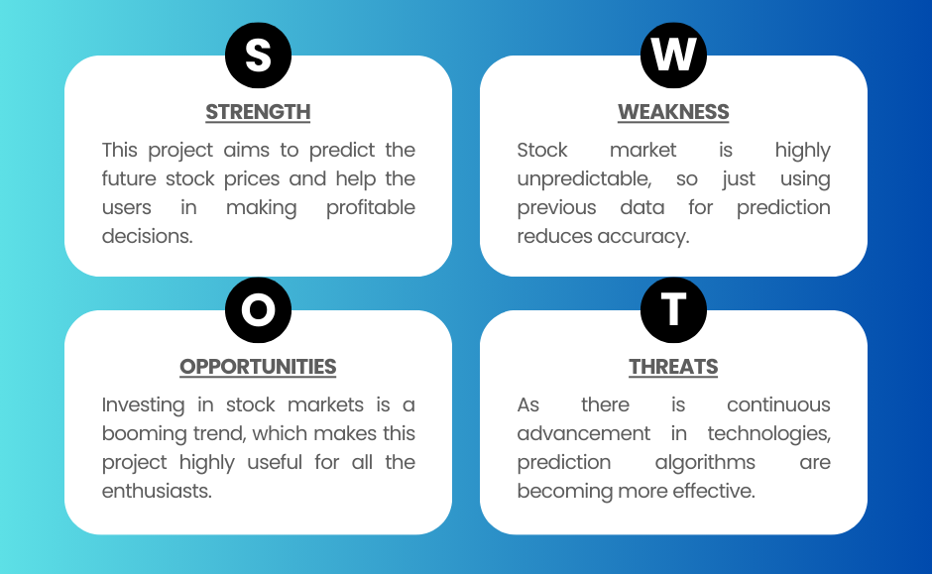
Literature Review
SWOT Analysis

Slide 6
Objective
Main Objective
The core objective of this endeavor is to help the user in increasing the profits in stock market trading.
Sub Objective
Finding applicable stock pricing datasets
Preprocessing the dataset to filter out the input values
Training the model
Testing the model and checking accuracy
Improving the model accuracy based on the testing results

Slide 7
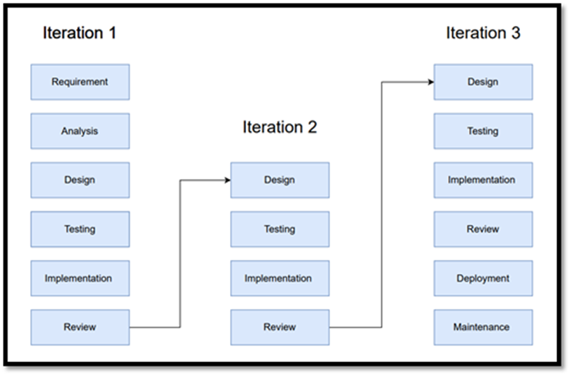
Methodology
Reference Software model
We will be using the Iterative Model to implement our project. The iterative method begins with a basic implementation of a limited set of software requirements in the iterative model, then repeatedly improves the evolving versions until the entire system is built and prepared for deployment.

Slide 8
Methodology
Steps
The methodology for our TradeHelp using deep learning techniques can be outlined as follows:
Dataset Collection: Firstly, a large dataset of stock prices is collected for training the machine learning model.
Model Selection: The next step is to select the machine learning models that will be used for prediction. Several popular prediction models are Regression, Random Forest, etc.
Model Training: The ML model learns prediction from the training data and predicts future stock prices .
Model Evaluation: After training, the model needs to be evaluated on a separate validation dataset to assess its performance.
Model Optimization: Based on the evaluation results, the model can be fine-tuned and optimized to improve its performance.

Slide 9
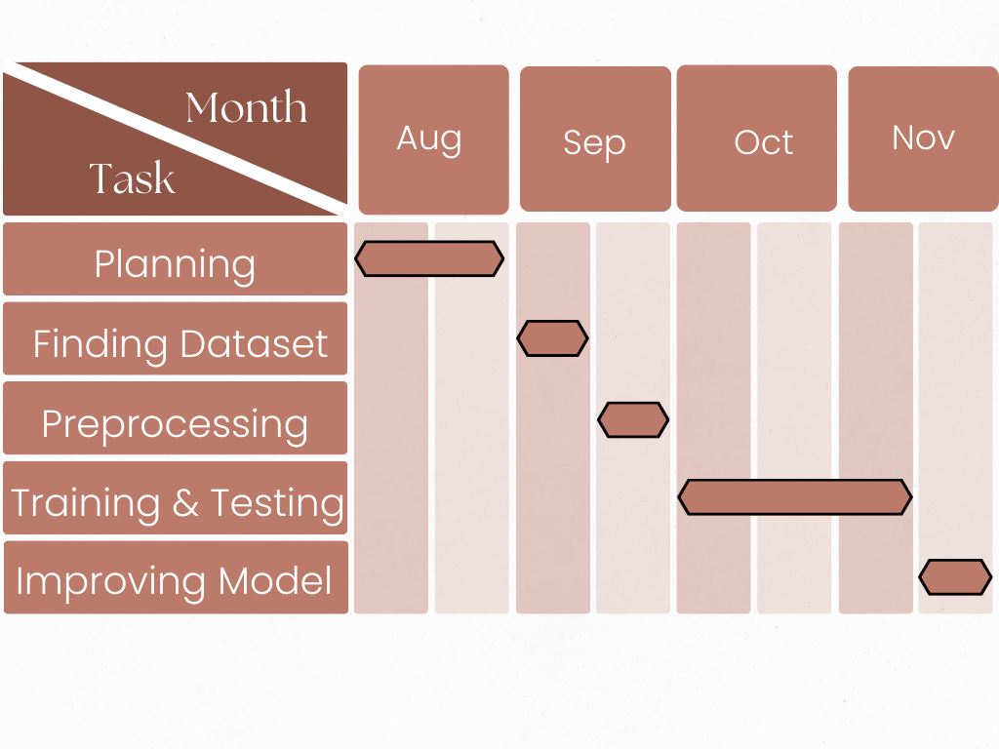
Methodology
Timeline

Slide 10
Reference
List of cited papers
[1] Stock Price Prediction using Linear Regression in Machine Learning
[2] (PDF) Analysis of stock market predictor variables using linear regression
[3] (PDF) Stock Market Analysis Using Linear Regression and Decision Tree Regression

Slide 11
Thank You

